Slide 1
Spring boot RestTemplate [JUnit]
SpringBootDemo
DB
REST Template Client
Consuming a RESTful Web Services by using REST Template client
REST Endpoints to Create/Update/Get/delete/Get list of Employee details

Slide 2
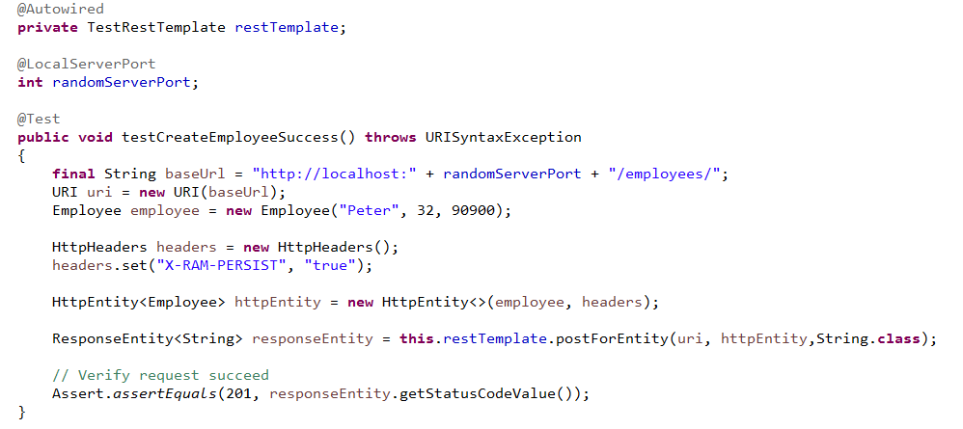
Spring boot RestTemplate [JUnit]
We will have to follow the given points to consume the API −
Autowired the RestTemplate Object.
Use HttpHeaders to set the Request Headers.
Use HttpEntity to wrap the request object.
Provide the URI, HttpEntity and Return type for postForEntity () method.

